Slide 1
PORT SCANNER
COMPUTER NETWORKS
GROUP NUMBER : 18

Slide 2
TEAM MEMBERS
SAURABH UDAI(16114061)
ARSHIYA KHAN(16116010)
BALRAM CHOUDHARY(16116015)
SHREY AGGARWAL(16116064)

Slide 3
INTRODUCTION
Implemented a legitimate technique of extracting information about what goes in out of various interconnected computers
First, we check whether the port is reachable or not
Second, we check whether it is in use or not

Slide 4
OBJECTIVE
Port scan is an act of systematically scanning a computer's ports
The vertical scan is a port scan that targets several destination ports on a single host
Single detection mechanisms are required in this scan
On the other hand a horizontal scan is a port scan that targets the same port on several hosts
We have implemented block scans, a combination of vertical and horizontal scanning styles

Slide 5
SOME COMMON PORTS
Port 20: FTP | Data port
Port 21: FTP | Control (Command) port
Port 22: SSH| Secure logins and file transfer
Port 23: Telnet | Unencrypted text communications
Port 25: SMTP | Used for e-mail routing between mail servers
Port 80: HTTP | Hypertext Transfer Protocol
Port 135: TCP | Microsoft Remote Procedure Call (RPC) service
Port 139: TCP | NetBIOS
Port 445: UDP | Microsoft-DS (Active Directory, Windows shares)

Slide 6
PROCEDURE
Testing the reachability of port using ping
Ping finds out the time taken for round trip for the messages send to a destination computer from the originating host which are echoed back to the source
If a host is reachable, then we send a SYN packet and if the acknowledgement is received then the port is in use and vice versa
For implementing block scan, we ran this process for a number of users which are interconnected through a local area network (LAN)

Slide 7
MAC ADDRESS DETECTION
The Mac Address batch file gets the list of MAC addresses of the active devices present in the network
Detecting address using arp command
Arp command is used to convert IP address to MAC address

Slide 8
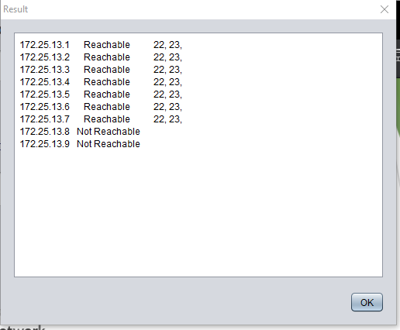
RESULT
This shows the list of all the ports that are reachable or not reachable along with the ports in use

Slide 9
Thank You

